Slide 1
Automated Camera Stand
IN 1900 (ICT Project)
Group - 47
Hardware Project

Slide 2




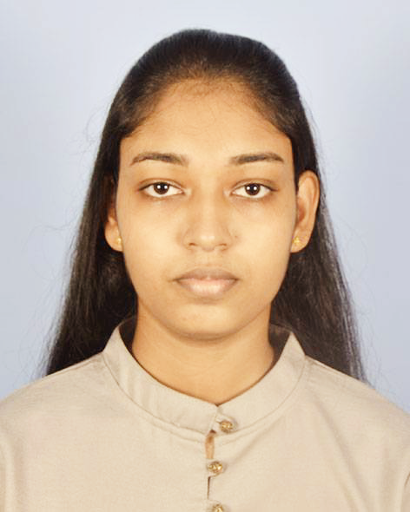
Group Members
Name | Registration Number | Photos
P.A.U.D. Herath (Team Leader) | 204074M
D.M.B.M. Dissanayake | 204047J
P.H.P. Jayathilaka | 204087F
S.P.S.N. Pathirana | 204150T
A.M.D.B.Rathnayaka | 204179N

Slide 3
Problem in Brief…
Not having a proper mechanism to bring the camera near to the required places or animals rather than a person carrying the camera.
From photographer’s side :
Danger to the life.
Time wastage.
Can’t find a good angle.
Can’t get close enough.
Constantly changing lighting conditions.
From animal’s side :
Animals get fear when we try to reach them.
Behaviours of the animals may get changed.
From environment side :
Bad impact on biodiversity.
Notes:
In modern cameras we have the feature to take remote photos (remote photography). Therefore, we can take pictures even we are far from the camera. But there is not a way to bring the camera near to the animals rather than a person carry the camera.
When we analyze the problem we found 3 main sides of this problem.
When we take from the photographer’s side; Imagine we need to capture a very close wild animal photo, we can’t reach it. Because It will be very dangerous. In past few years many wildlife photographers has died due to animal attacks.
We have to spend lot of time, until the required animals come, to capture their photos.
When the photographer need to take a good quality photograph, taking a close correct angle is an essential thing. But the photographers can’t go near the animals to achieve those requirements.
From animal’s side : If the animal is an innocent one, it does not stay until we go near them.

Slide 4
Project Aim
Automate the distance photography process to make sure it is safer and effective.

Slide 5
Project Objectives
Rotate the camera both vertically and horizontally.
Move the stand according to given GPS coordinates.
Reach the target safely.
Adjust the height of the rod.
Protect the camera from the animals by using the alarm.
Control the camera holder using a remote controller.
Notes:
If an animal try to attack the camera holder then we can sound the alarm. Like that we can ensure the safety of the camera.

Slide 6
Proposed Solution
Processes
Input
Output
Remote Controller
Motion Signals
Remote Controller Signal Processing
Camera Stand Motions
4 x Gear Motors
Keypad
GPS Coordinates
Camera Alignment
Servo Motors
Current Location
GPS Location Guiding
GPS Sensor
User Instructions
Display x 2
Compass Sensor
Angle from North
Obstacle Avoiding
Siren Signal
6 x Ultrasonic Sensor
Distance
Siren
Notes:
Remote Controller sends motion signals and processes the remote controller signals to rotate the motors and also the alarm.
We can input the GPS coordinates by using the Keypad.

Slide 7
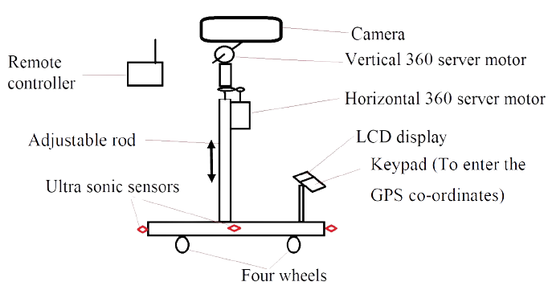


Sketch of the camera stand
This head section fits with the stage
))
RF antenna
Siren
Project Box

Slide 8
Resources (Software)
Atmel Studio (Microcontroller Coding)
Notes:
Up to this state we identified only these softwares. And it may be changed. The softwares are ; 1. 2. 3.

Slide 9
Resources (Hardware)
Microcontroller
GPS Module
RF Transmitter and Receiver
Ultrasonic sensor
Gear Motors
Servo Motors
LCD Module
Motor Driver Module
Electronic Compass Module
Keypad
Li-Po Batteries
Joystick Module
Notes:
These are the hardwares which we suppose to use.

Slide 10
Cost Estimation
Component | Unit Price | Quantity | Price (LKR)
Membrane Keypad - 16 Key | 180 | 1 | 180
HC-SR04 Ultrasonic Sensor Module | 200 | 6 | 1200
NEO-6M GPS Module | 1850 | 1 | 1850
L298N DC Motor Driver Module | 350 | 2 | 700
Servo Motor | 750 | 2 | 1500
Atmega32 Microcontroller | 550 | 2 | 1100
11.1V 2200mAh 3S 25C Li-Po Battery | 2800 | 1 | 2800
12V 2000mAh Li-Po Battery | 1750 | 1 | 1750
DC Gear Motor 12v 180 RPM | 950 | 4 | 3800

Slide 11
Cost Estimation (Contd.)
Component | Unit Price | Quantity | Price (LKR)
68mm RC Car Tire Wheel | 300 | 4 | 1200
Liquid Crystal 16x2 Display Module | 300 | 1 | 300
2 Pin Switch | 15 | 2 | 30
Thumb Joystick Module | 150 | 2 | 300
RF 433MHz Transmitter/Receiver | 200 | 1 | 200
28BYJ-48 Stepper Motor with Driver | 370 | 1 | 370
GY-271 Electronic Triple Axis Compass Module | 700 | 1 | 700
Total |  |  | 17,980
Lankatronics (Pvt) Ltd, Microchip.lk
Notes:
The total cost which we suppose to spend for this project is Seven thousand nine hundred and eighty rupees.
And we took all these unit prices referring the Lanka tronics private limited and Microchip.lk web sites.

Slide 12
How the works are divided…?
 | Hardware Part | Software Part
Member - 01 | Servo motors Alarm | Servo Controlling Trigger Alarm
Member - 02 | GPS sensor Compass sensor | GPS location guiding
Member - 03 | Ultrasonic sensors Gear motors with wheels. LCD display and Keypad. | Obstacle Avoiding Motor Controlling Get Inputs from keypad and display
Member - 04 , 05 | Custom remote controller RF Transmitter and Receiver | Communication between Remote and Camera stand

Slide 13

Notes:
Sir , madam ; If there are any questions about the project we will be happy to answer them.
https://www.youtube.com/watch?v=cZm4ZjE-zaU

Slide 14

Group - 47
Notes:
Our presentation is over, thank you !!

